Slide 1
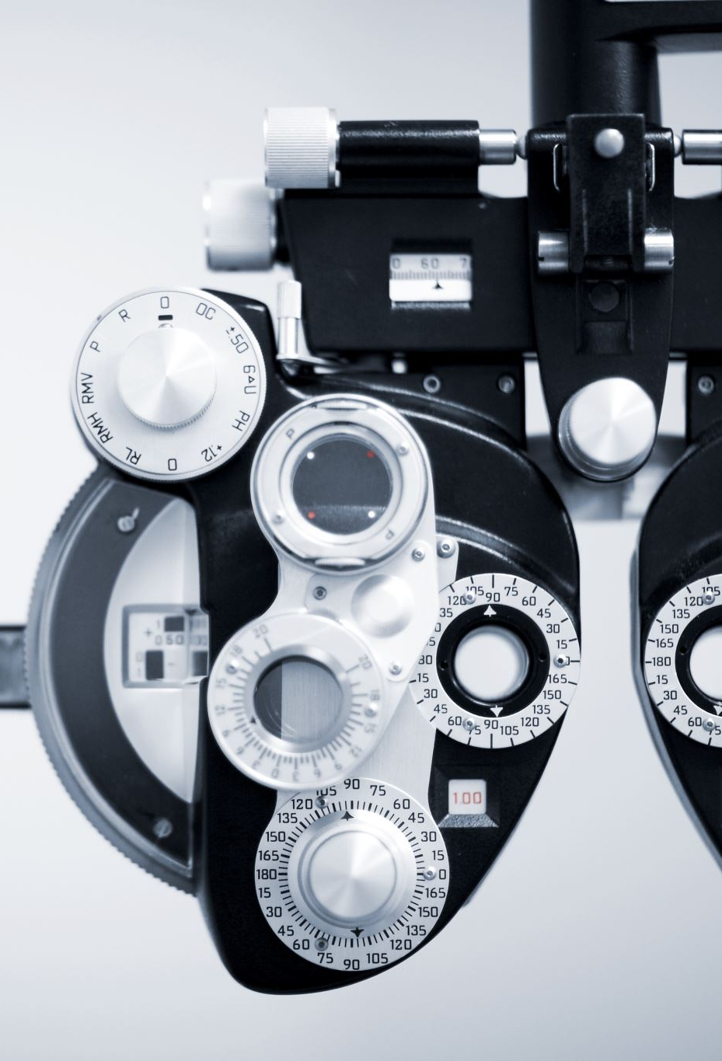
Automated Detection of Skin Cancer from Dermatological Images
Team Members: Yeshwanth Reddy Katta
Xudong Zhao

Slide 2
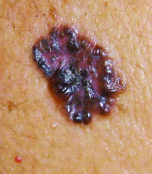
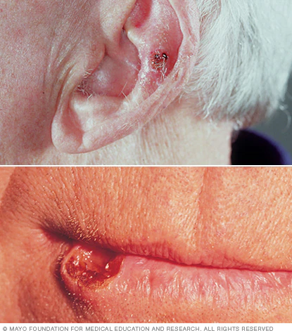
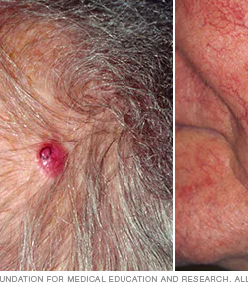
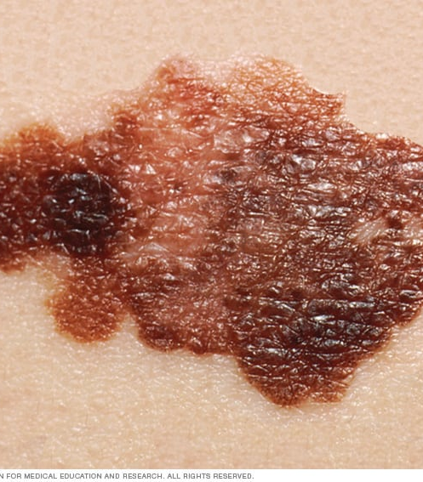
Introduction
Skin Cancer:
The abnormal growth of skin cells
Main Types:
Basal cell carcinoma, Squamous cell
carcinoma, Merkel cell cancer,
Melanoma
Causes:
Ultraviolet radiation
Notes:
Skin cancer — the abnormal growth of skin cells — most often develops on skin exposed to the sun. But this common form of cancer can also occur on areas of your skin not ordinarily exposed to sunlight.
There are three major types of skin cancer — basal cell carcinoma, squamous cell carcinoma and melanoma.
You can reduce your risk of skin cancer by limiting or avoiding exposure to ultraviolet (UV) radiation. Checking your skin for suspicious changes can help detect skin cancer at its earliest stages. Early detection of skin cancer gives you the greatest chance for successful skin cancer treatment.

Slide 3

Motivation
Importance of Early Detection
Increasing the survival rate
Machine Learning in Dermatology
SVM
CNN

Slide 4
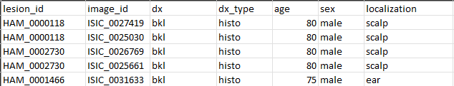
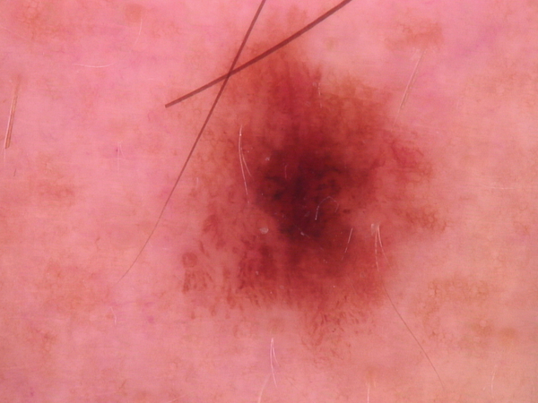
Datasets Used - Ham10000
Metadata(CVS File)
Dx is diagnostic categories of seven skin lesion types, namely
actinic keratosis (akice), basal cell carcinoma (bcc). benign keratosis
(bkl) dermatofibroma (dt), melanocytic nevi (ny), melanoma (mel)
and vascular skin lesions (vase).
Image(JPG File)
10015 Dermatoscopic Images

Slide 5
Model Design – Data Preparation and EDA
Data Preparation
Training set size: 7210
Validation set size: 1803
Test set size: 1002
EDA
Preforming exploratory data analysis on the data set

Slide 6
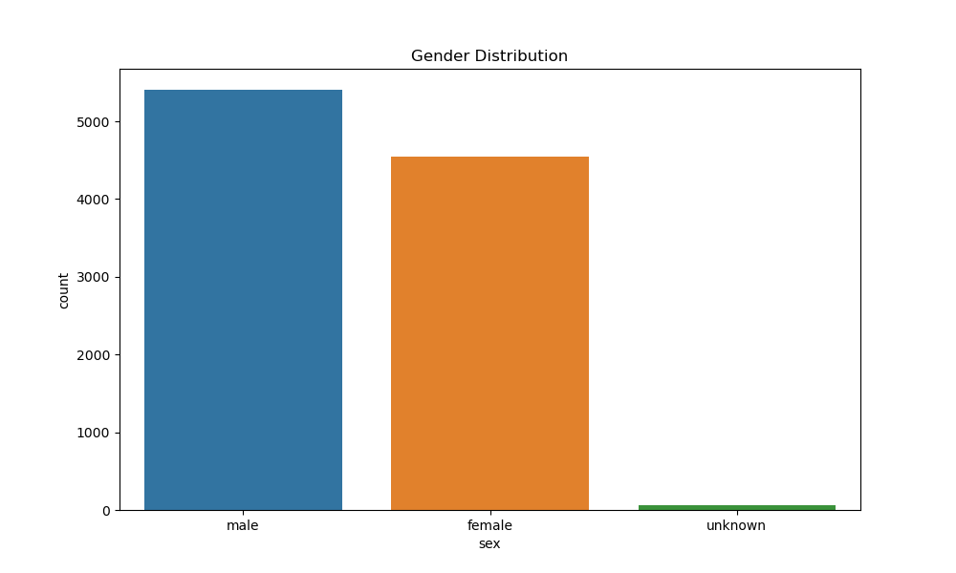
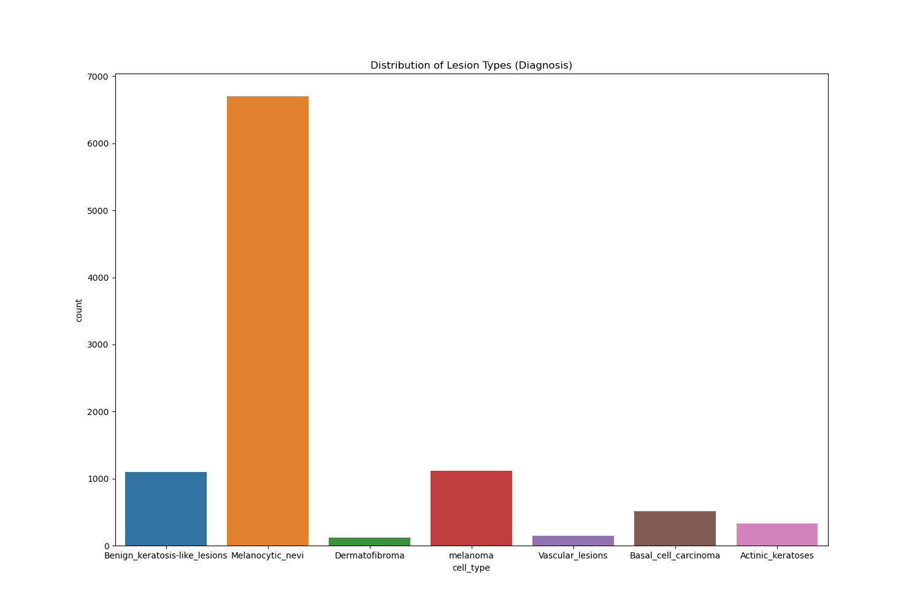
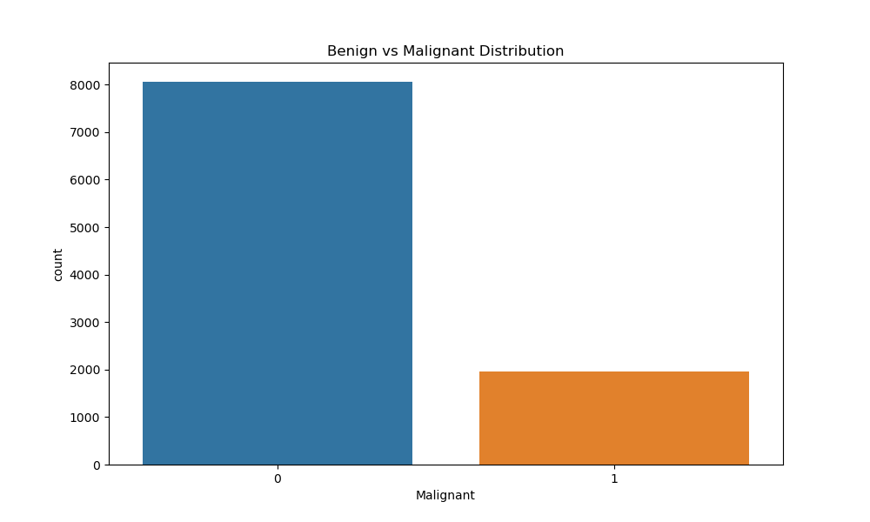
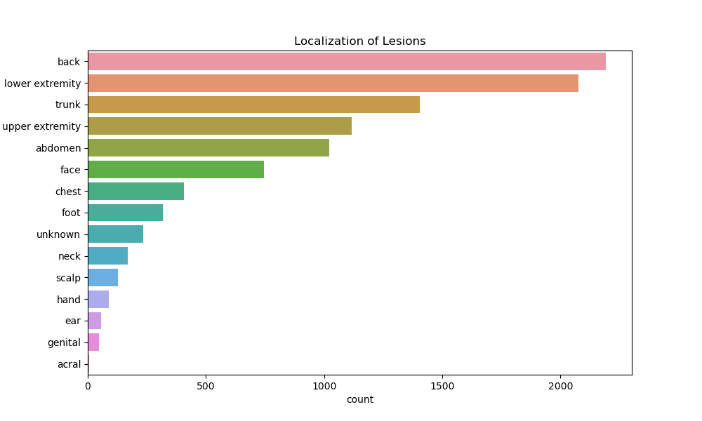
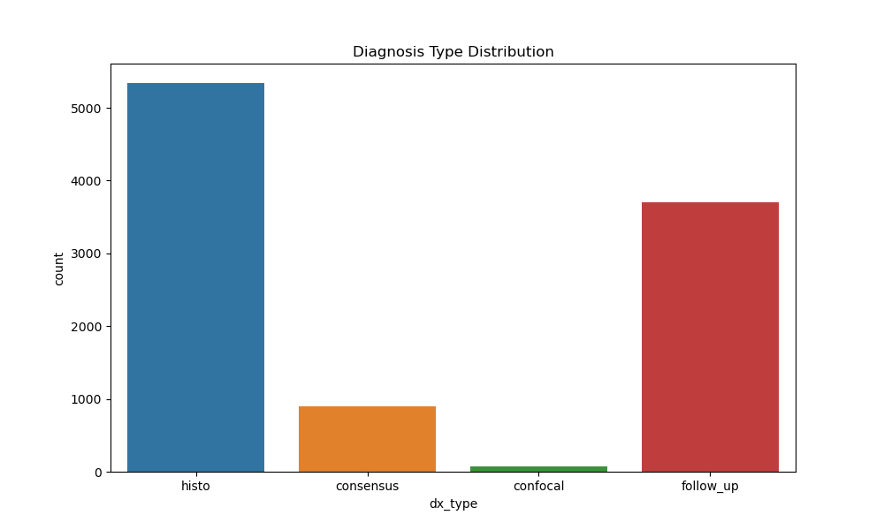
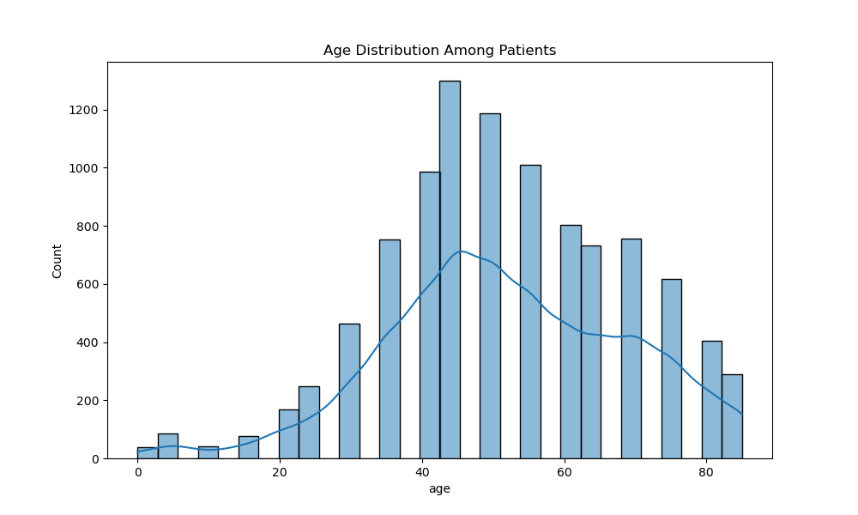
Model Design – Data Preparation and EDA

Slide 7
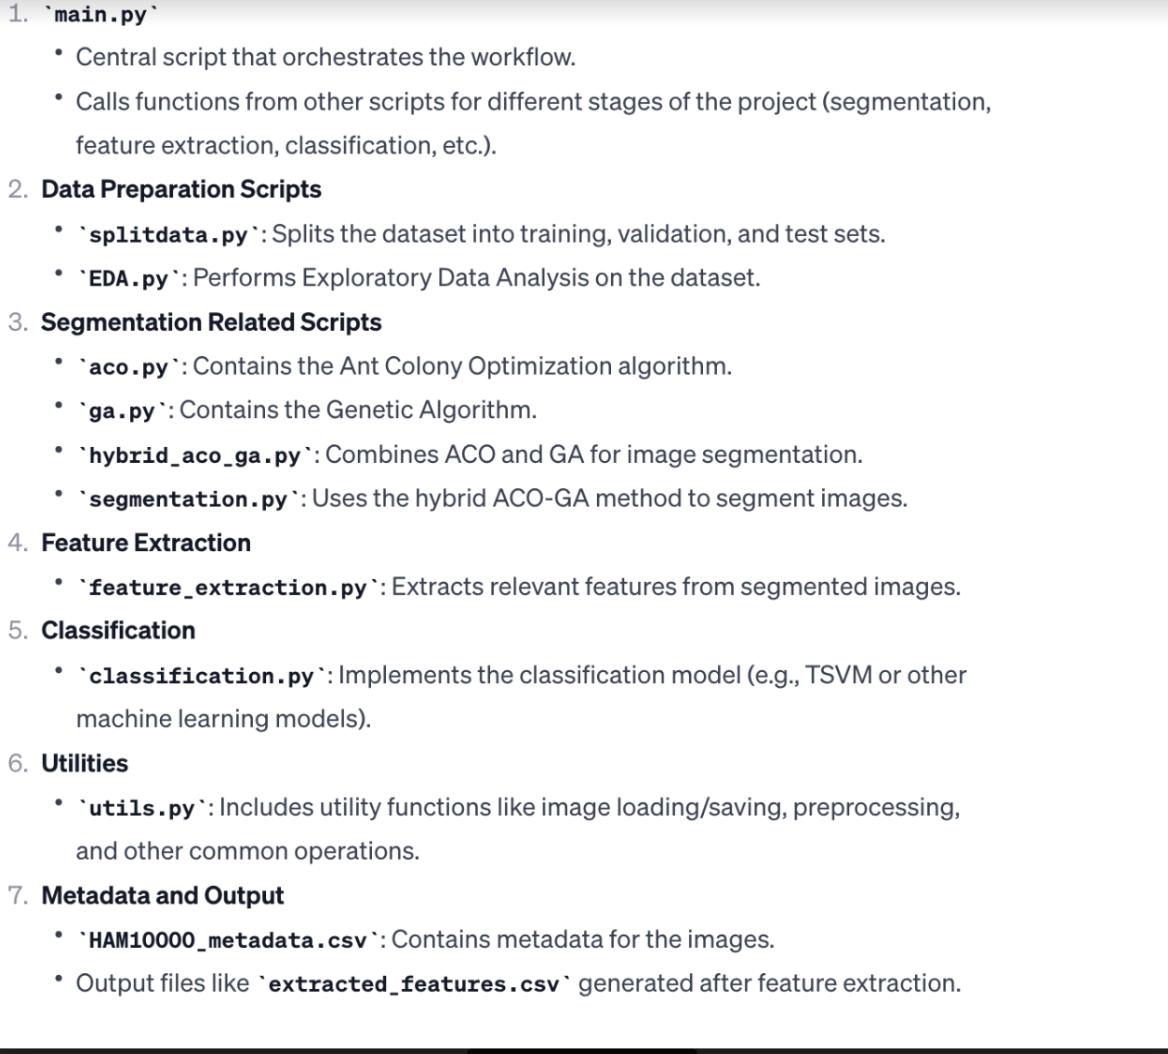
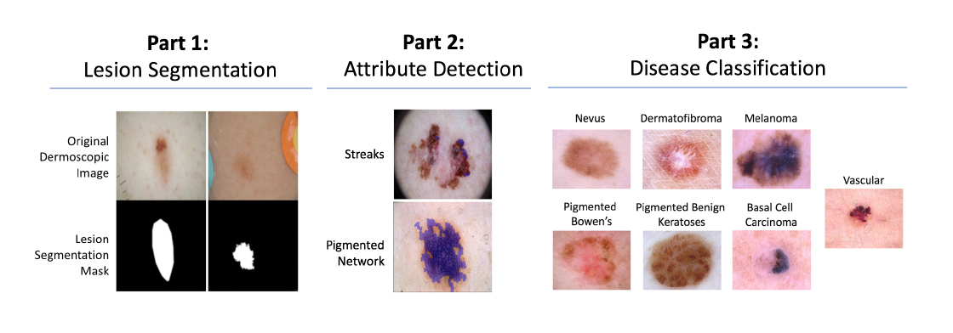
Work Flow

Slide 8
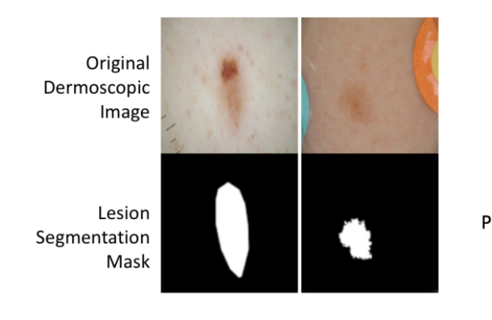
Model Design – Segmentation
Method: Hybrid ACO-GA
hybrid approach for image segmentation
This binary mask differentiates the region of interest (ROI), such as a lesion or any specific feature
Advantage:
Improved precision.
Ability to handle large size of the data.

Slide 9
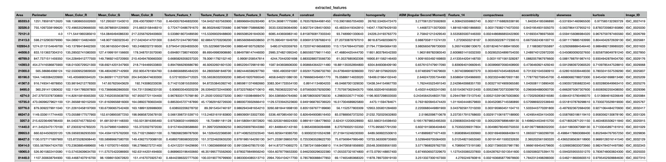
Model Design – Feature Extraction

Slide 10
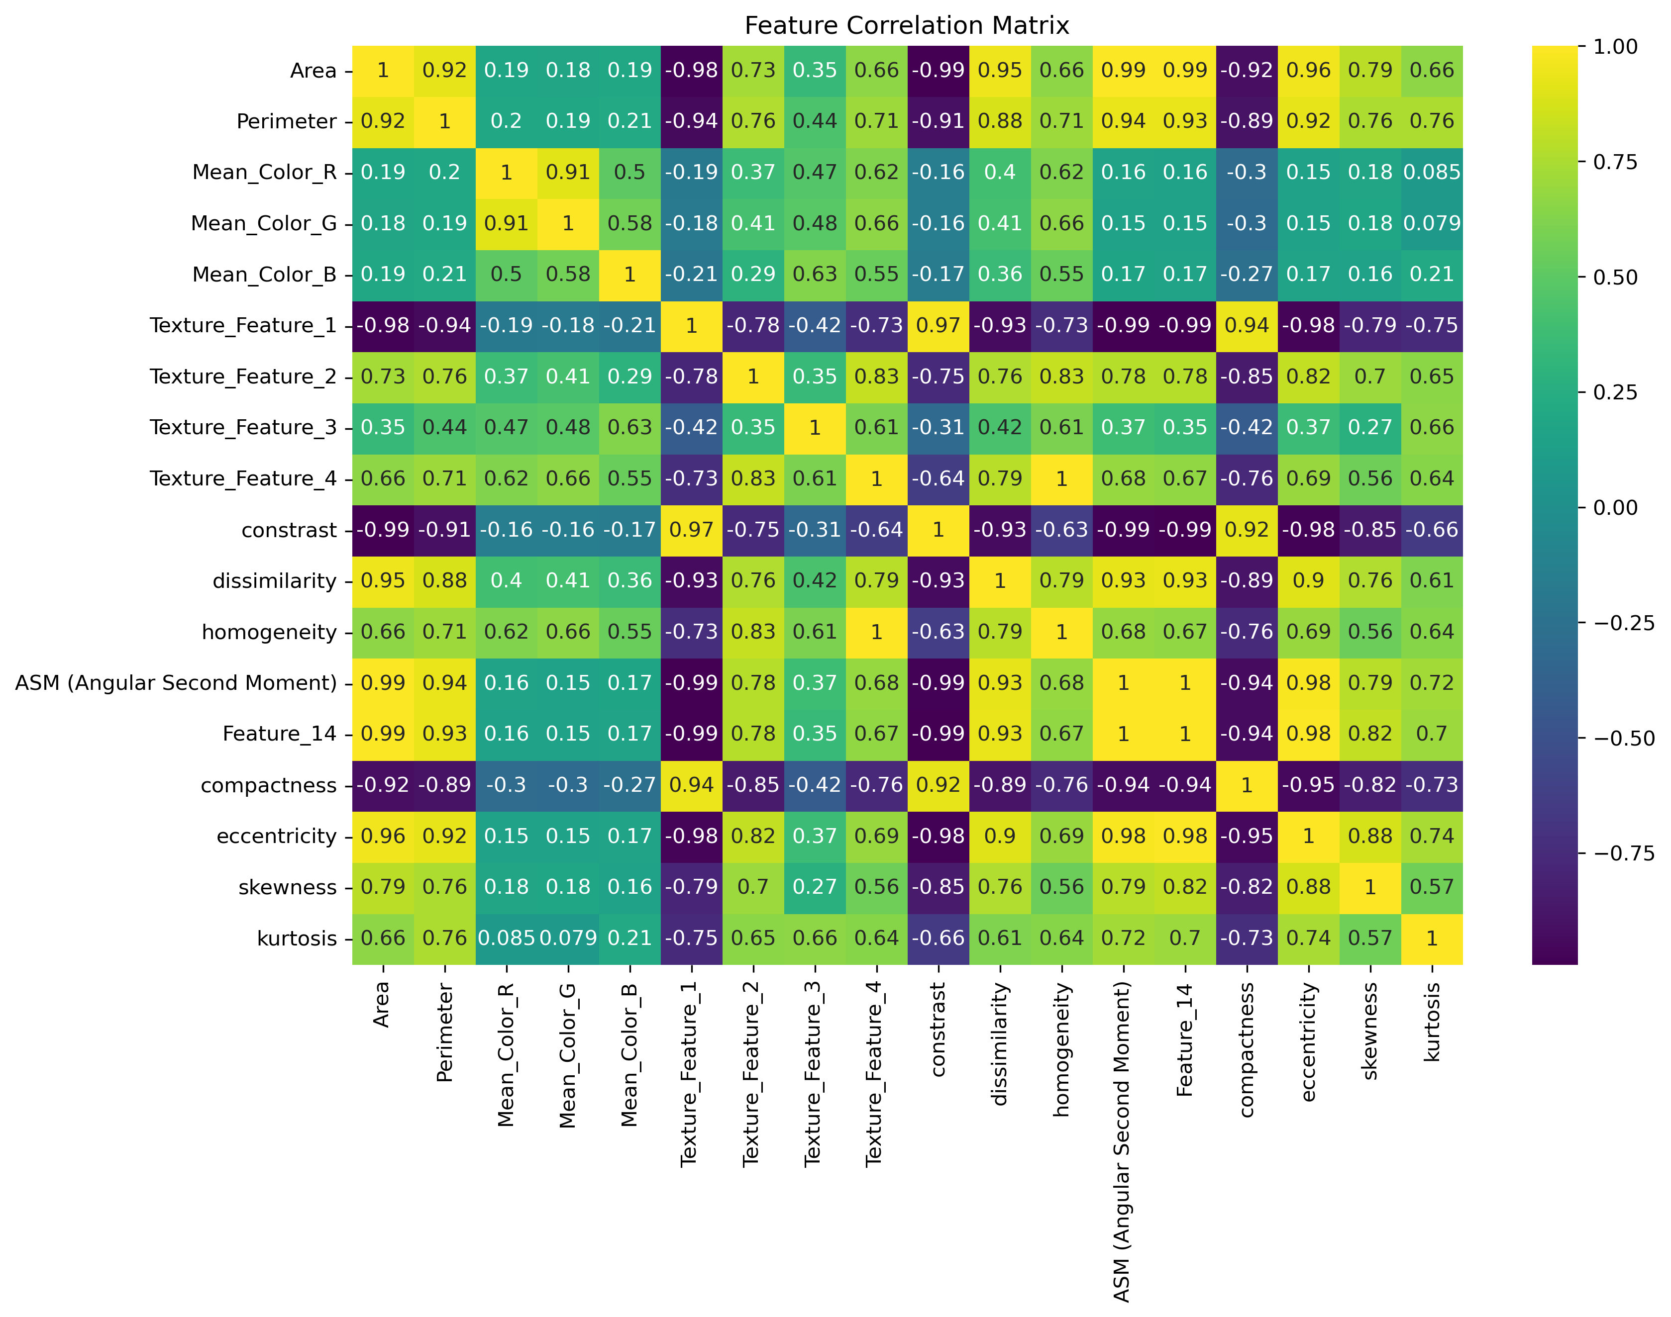
Model Design – Feature Extraction
Identify and extract relevant features from the segmented images that can be used for classification.
texture analysis, color distribution, border irregularity
Outputs:
Generated an extracted features.csv used for training the classification model.

Slide 11
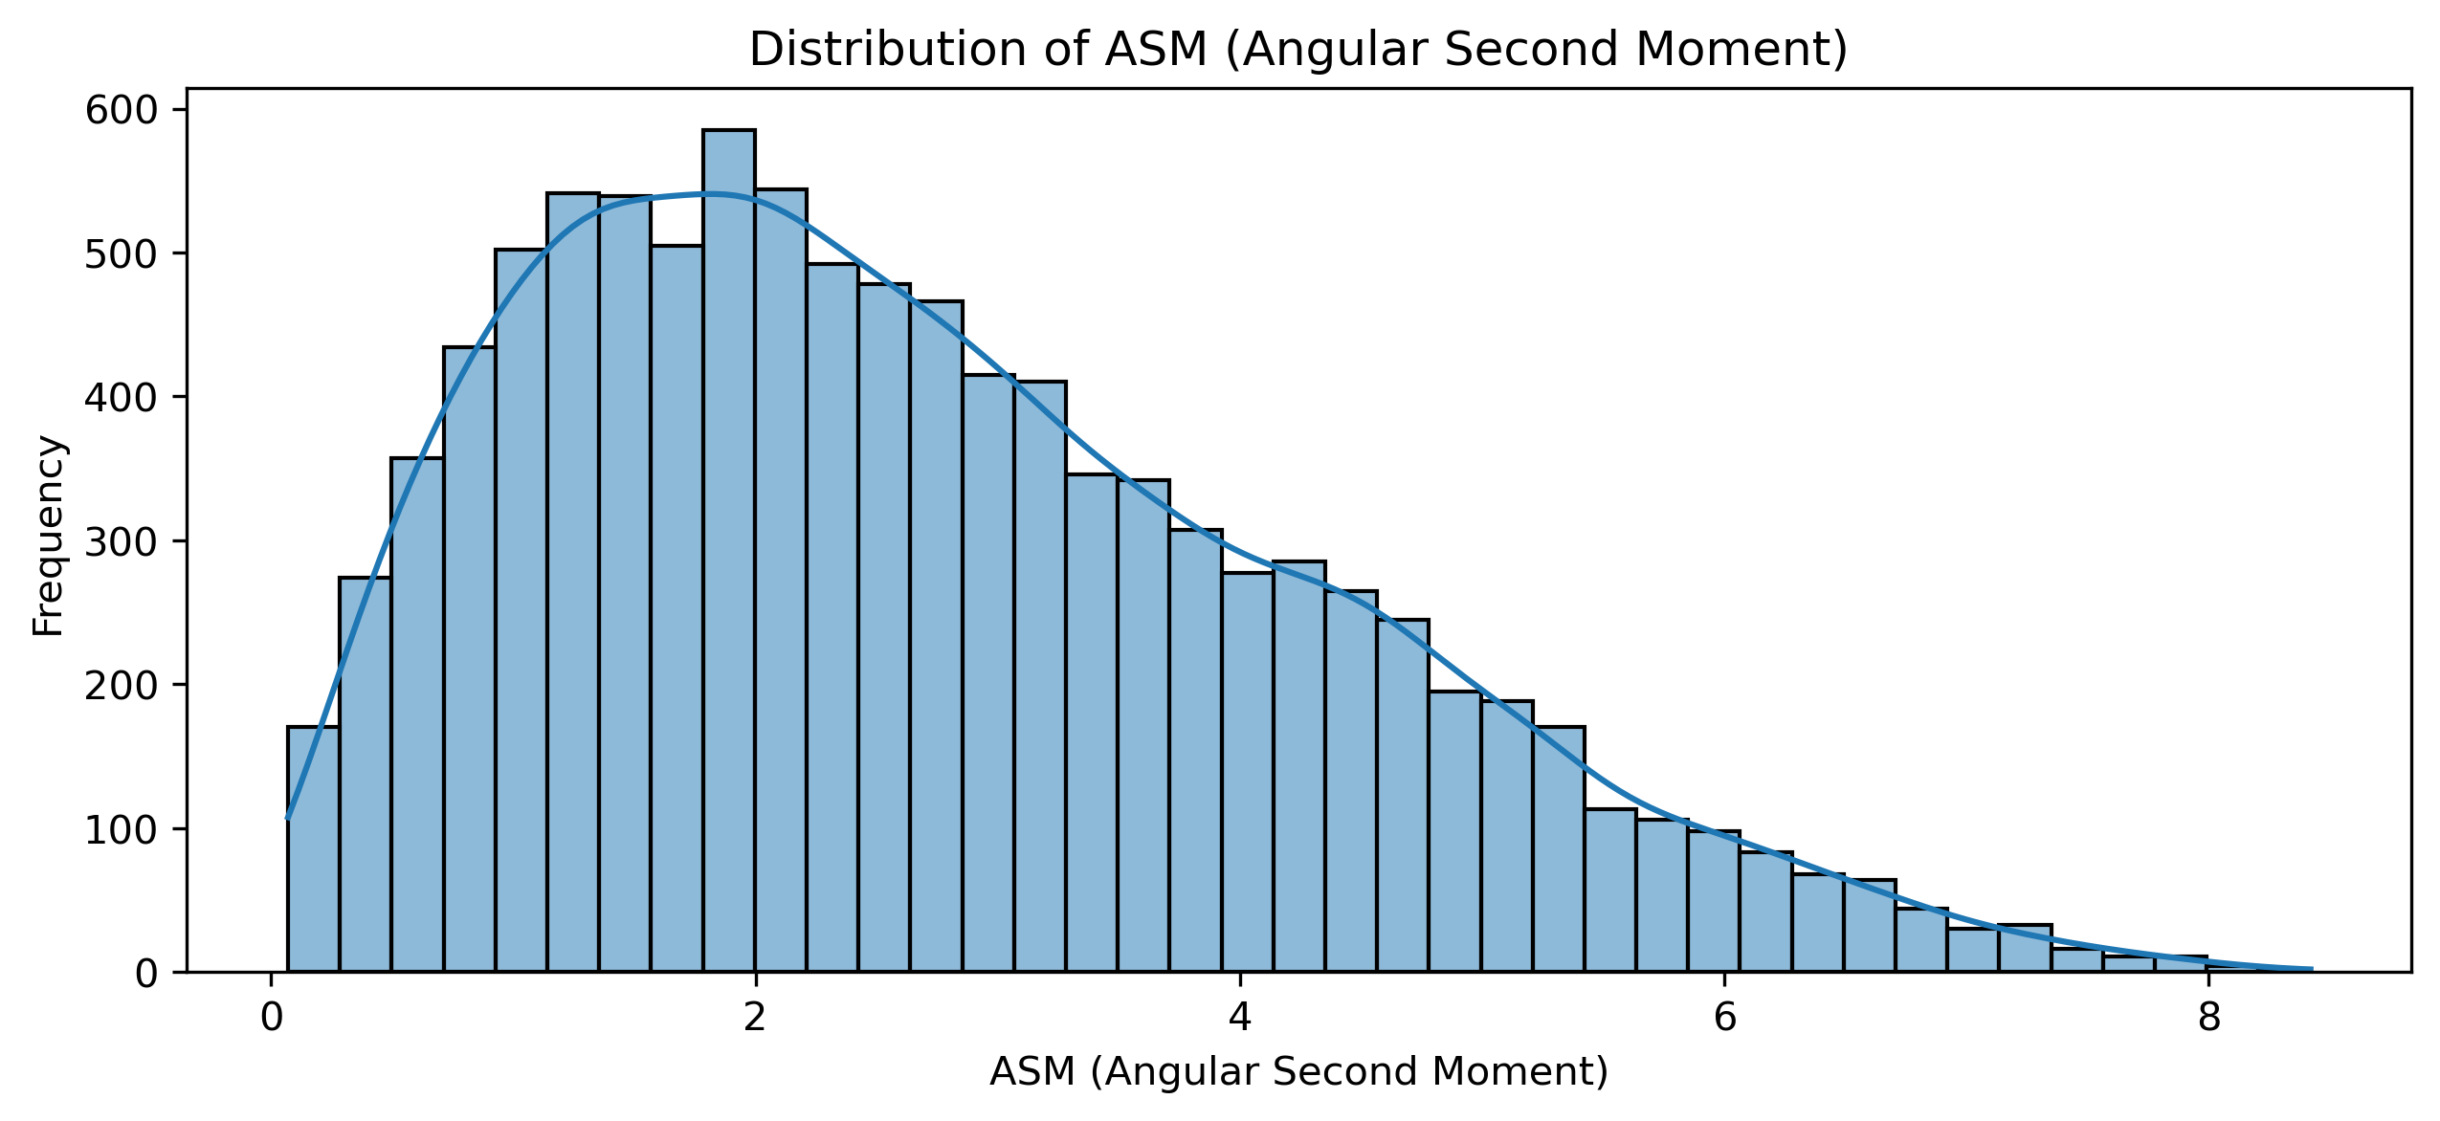
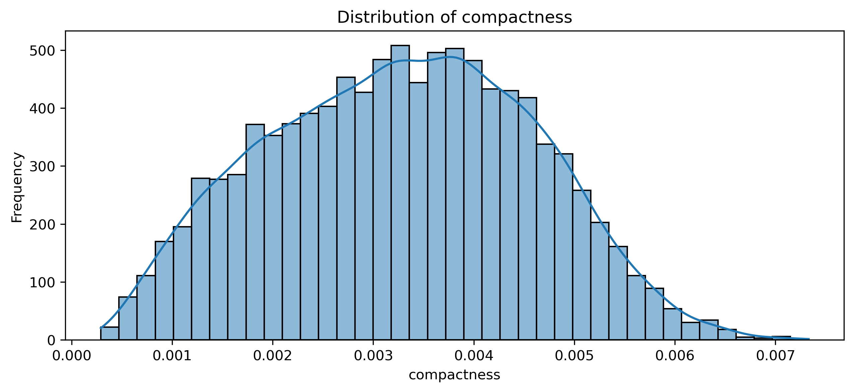
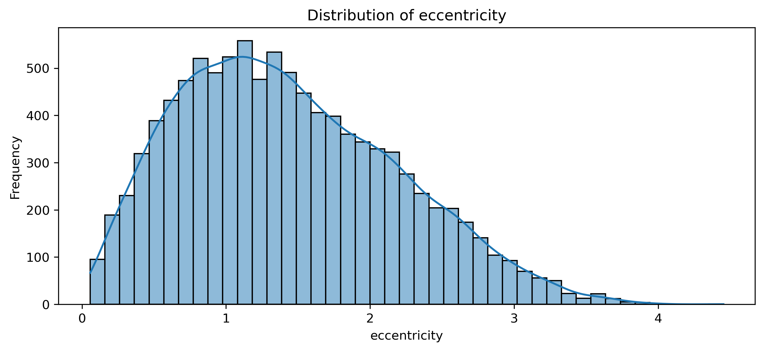
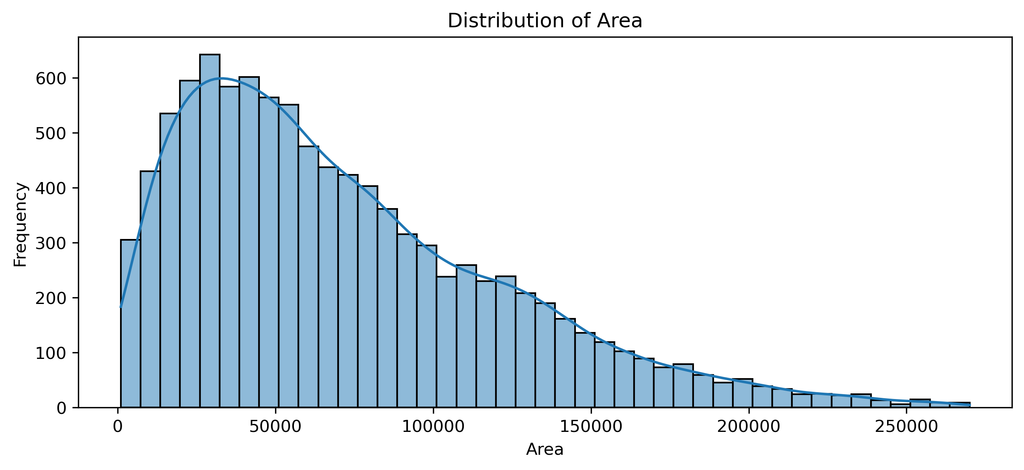
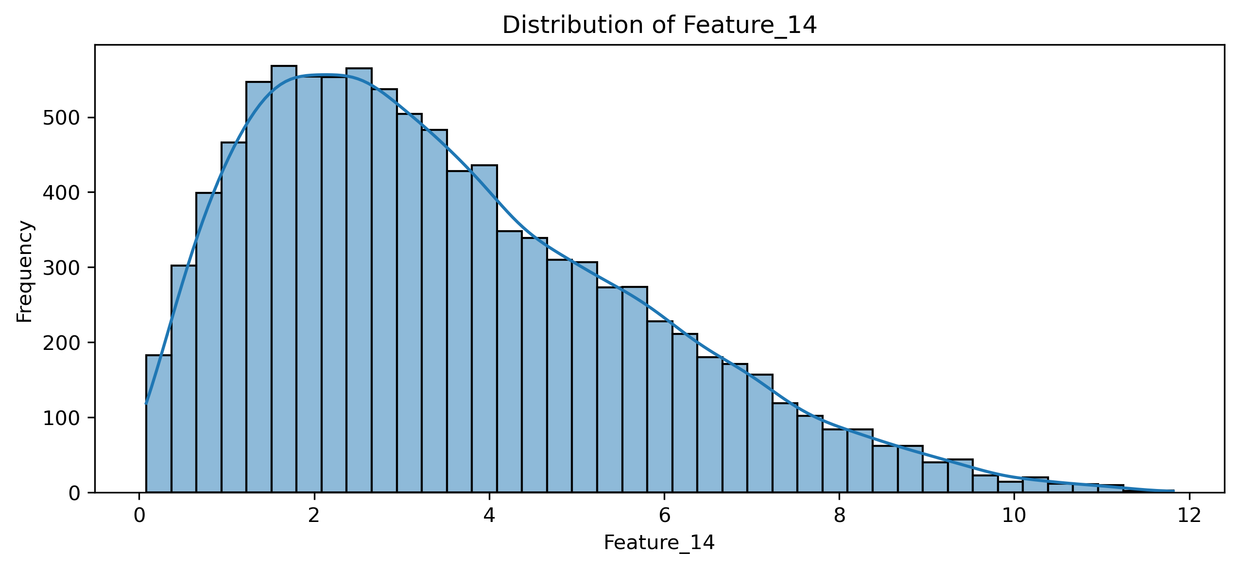
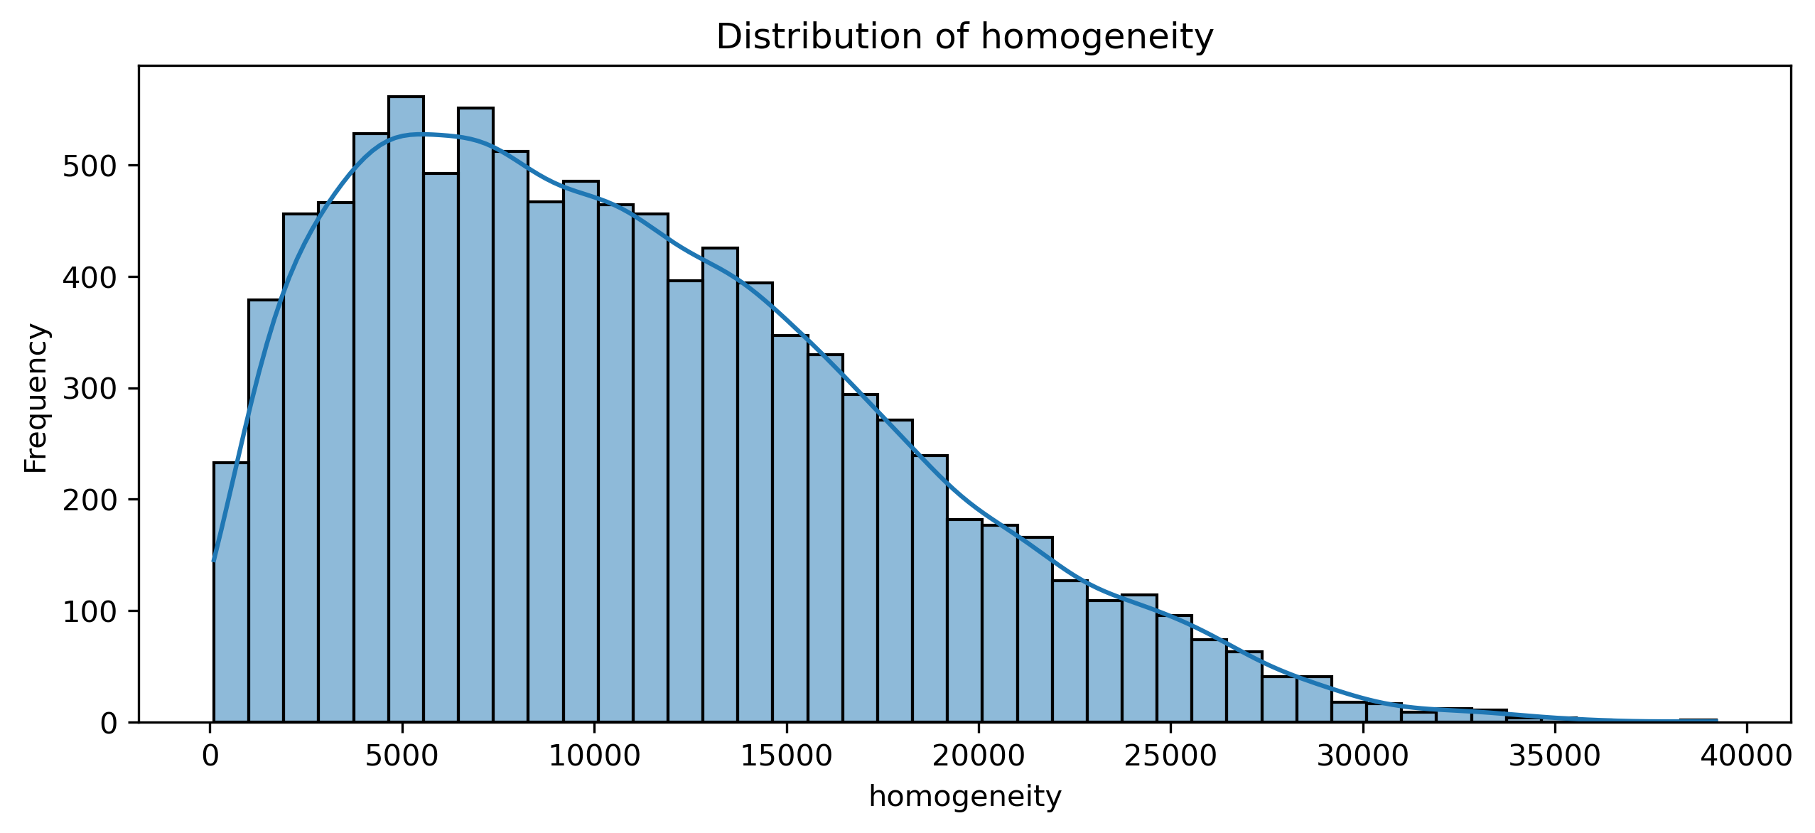
EDA Feature Extraction

Slide 12
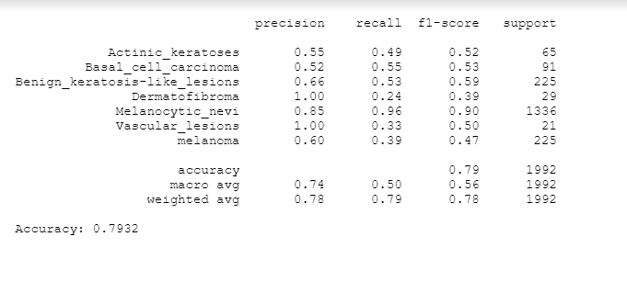
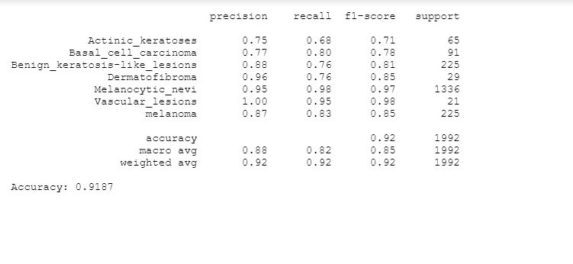
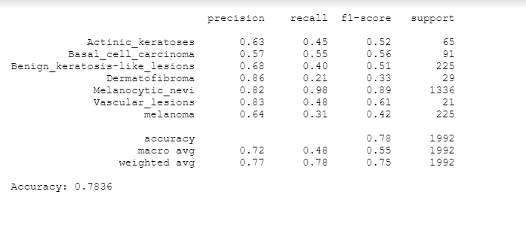
Model Design – Classification
RBF
SVM – Support vector machines are a set of supervised learning methods used for classification, regression, outlier detection.
Accuracy:
RBF: 79.32%
Linear: 91.87%
Polynomial: 78.36%
Linear
Polynomial

Slide 13
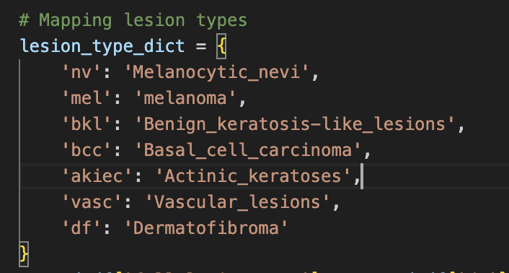
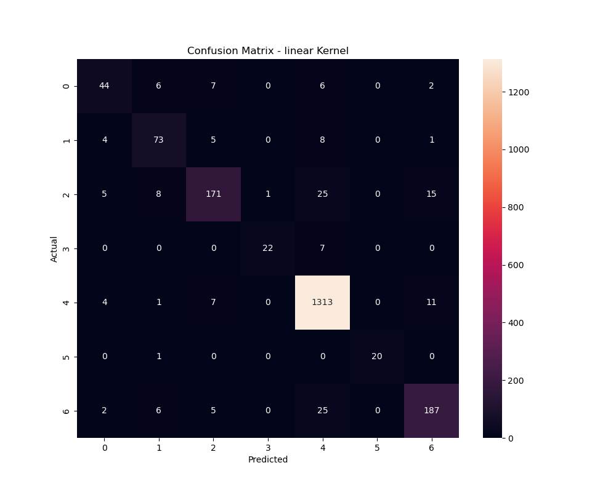
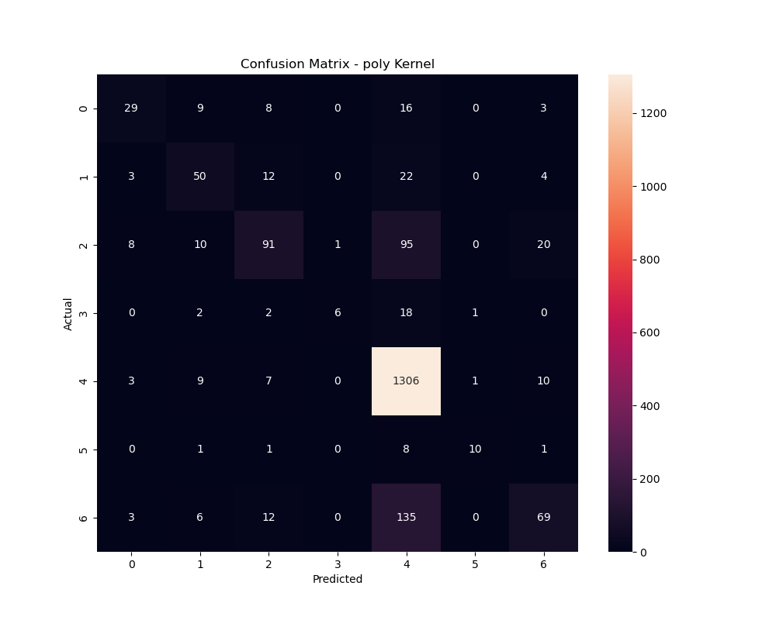
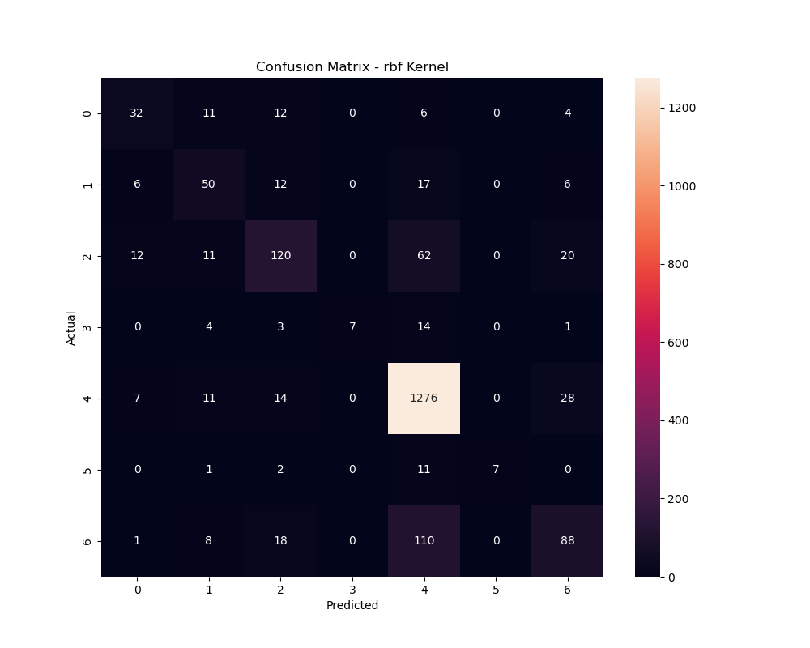
SVM ALGORITHM-CONFUSION MATRIX

Slide 14
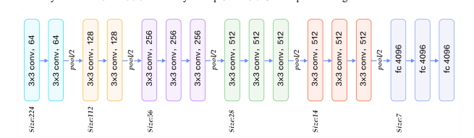
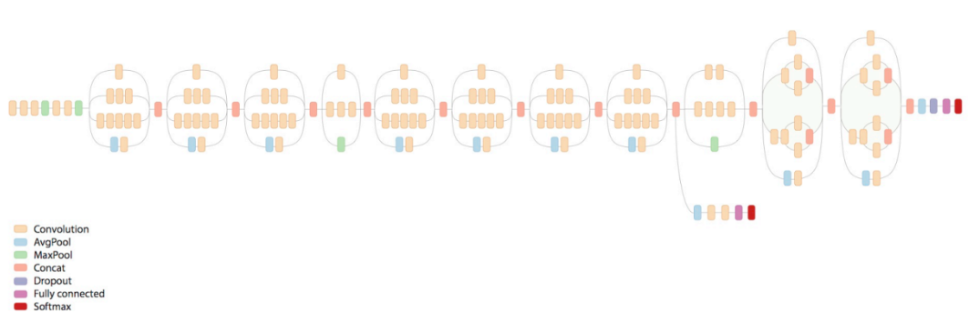
Model Design – CNN Classification
VGG16:
VGG16, developed by Visual Graphics Group, contains 16 layers(Convolutional layers, Pooling
layers, and fully connected layers). By using 3 x 3 filters, VGG16 can capture fine details in images.
INCEPTION V3:
Factorized convolution reduces the number of parameters
Symmetric and Asymmetric building blocks

Slide 15
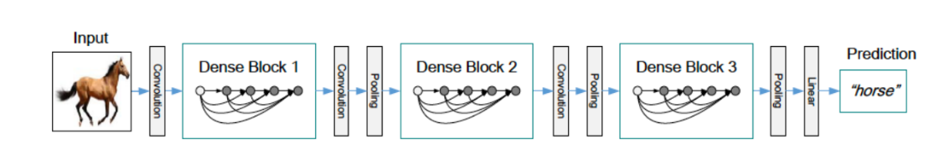
Model Design – CNN Classification
DENSENET 201: 201 layers deep

Slide 16
Observation and Future work
MODEL | VALIDATION | TEST | TEST LOSS
VGG16 | 86.92% | 86.826% | 0.6241
INCEPTION V3 | 86.696% | 87.725% | 0.5587
Dense Net 201 | 88.8% | 88.52% | 0.41156
SVM CLASSIFIER | 90.82% | 91.97% | 0.2116
Results comparison between SVM and CNN

Slide 17

Improvements for the model
Improve parallel processing of data for faster segmentation of images.
Investigate deep feature extraction methods using pre-trained CNN models (like VGG, ResNet) as feature extractors.
Perform statistical tests (like t-tests or ANOVA) to assess the significance of the performance differences between models.

Slide 18

Thank You!

